Slide 1
Willson Financial
Module 11.2 Case Study Project Presentation
CSD310 Database Development & Use | Brittaney Perry-Morgan

Slide 2
Introduction
Willson Financial – Case Study Project
Solo Project by Brittaney Perry-Morgan

Slide 3

Case Study Overview
Willson Financial is a registered financial advisory firm in New Mexico, serving ranchers, farmers, and retirees.
Key Needs:
Track Client Growth
Monitor Assets
Analyze Transactions
Evaluate Billing Models.

Slide 4
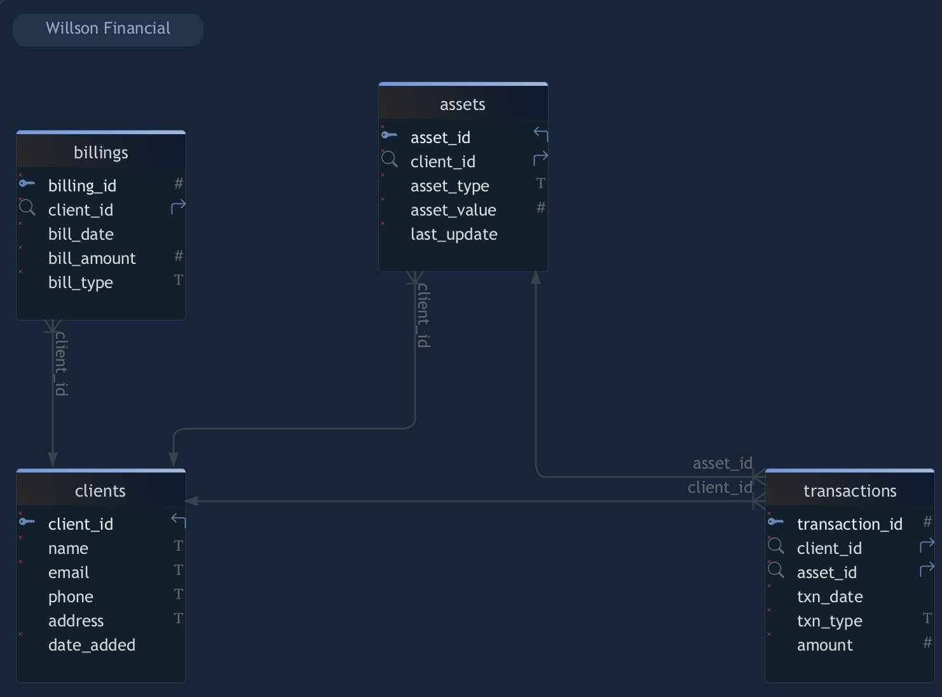
Finalized ERD Diagram
Entities: clients, assets, transactions, billings
Each client can have multiple assets, transactions, and billings.
Assets and transactions are linked, and all use plural names to match the implementation.

Slide 5
Key Assumptions
Table/column names are plural to match the implementation.
The database is in 3NF.
Only active clients are included in reporting.
Asset values use the last_update date.
Billing is per client, per month, flat, or percent.
Transactions include deposits, withdrawals, and trades.

Slide 6
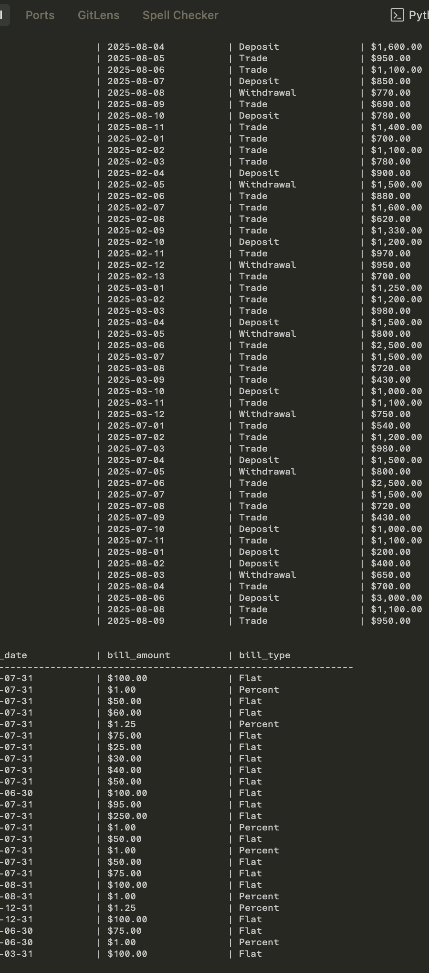
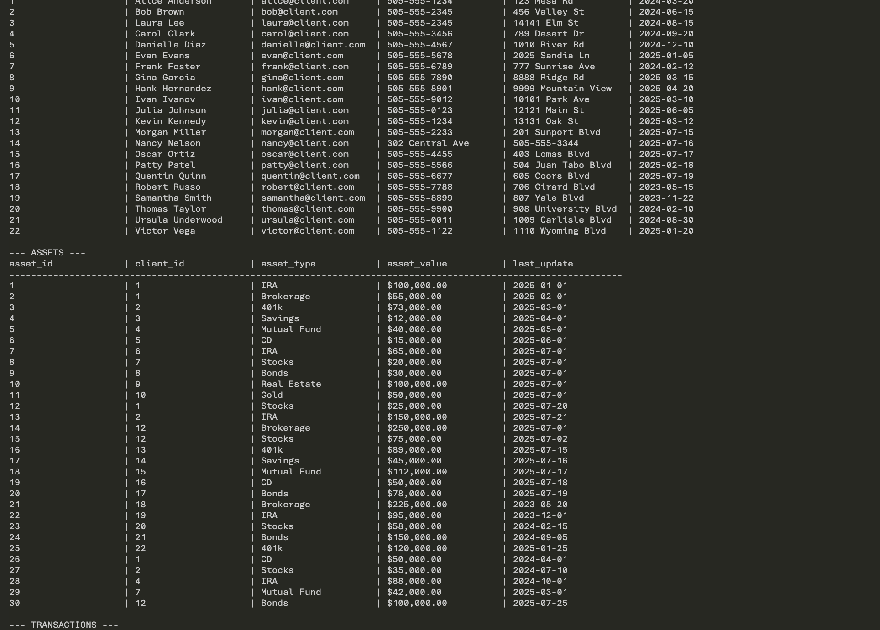
Business Reports - Overview
New Client Growth (Last 6 Months)
Average Assets Per Client
High-Transaction Clients (> 10/Month)

Slide 7
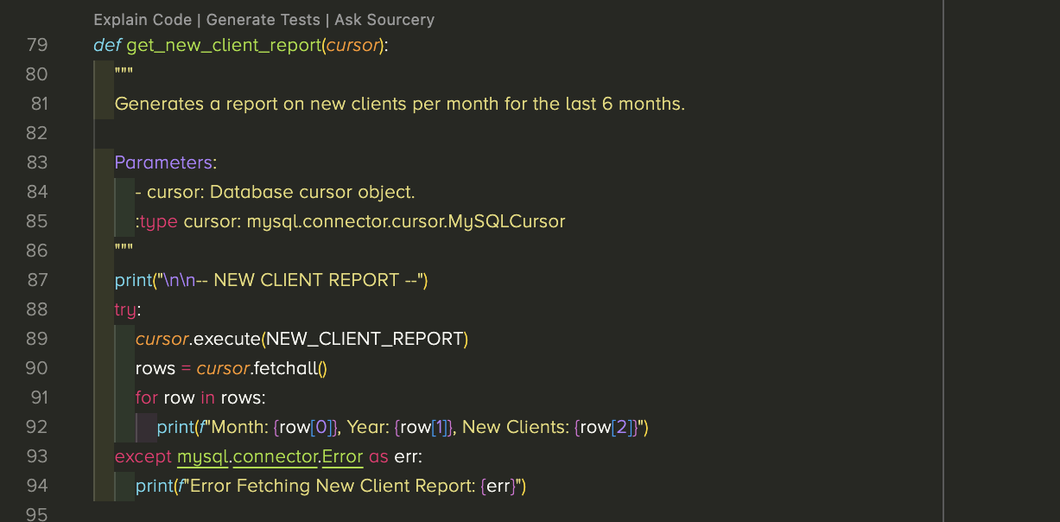
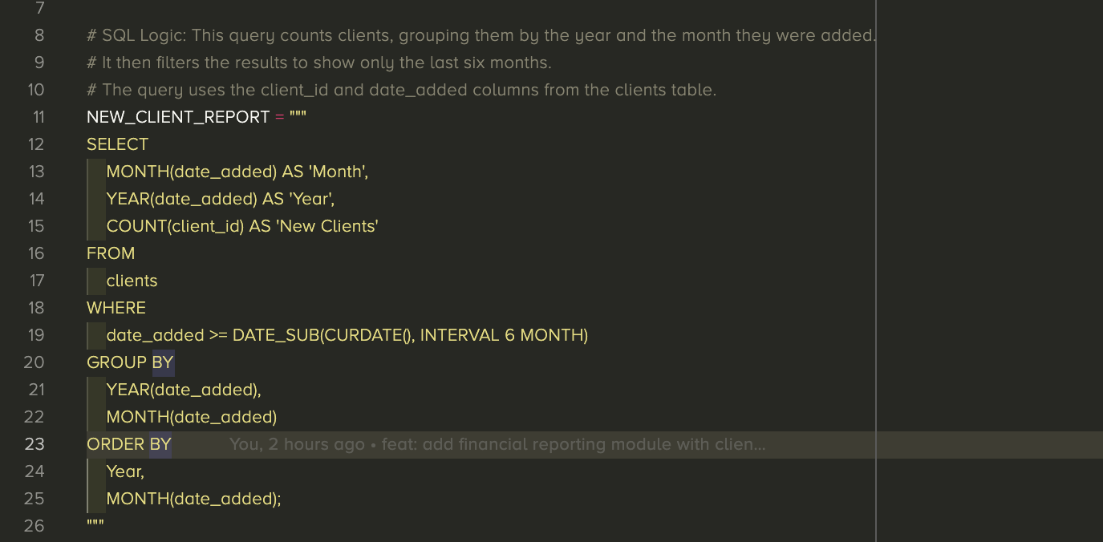
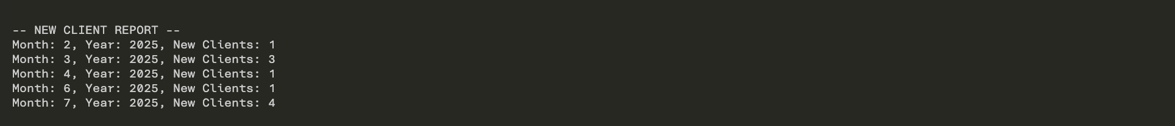
Report 1 – New Client Growth
Business Need: Track growth and marketing effectiveness.
Description: Count of new clients by month/year (last 6 months).

Slide 8
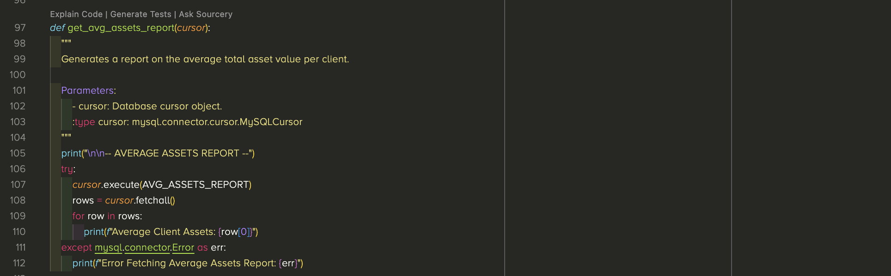
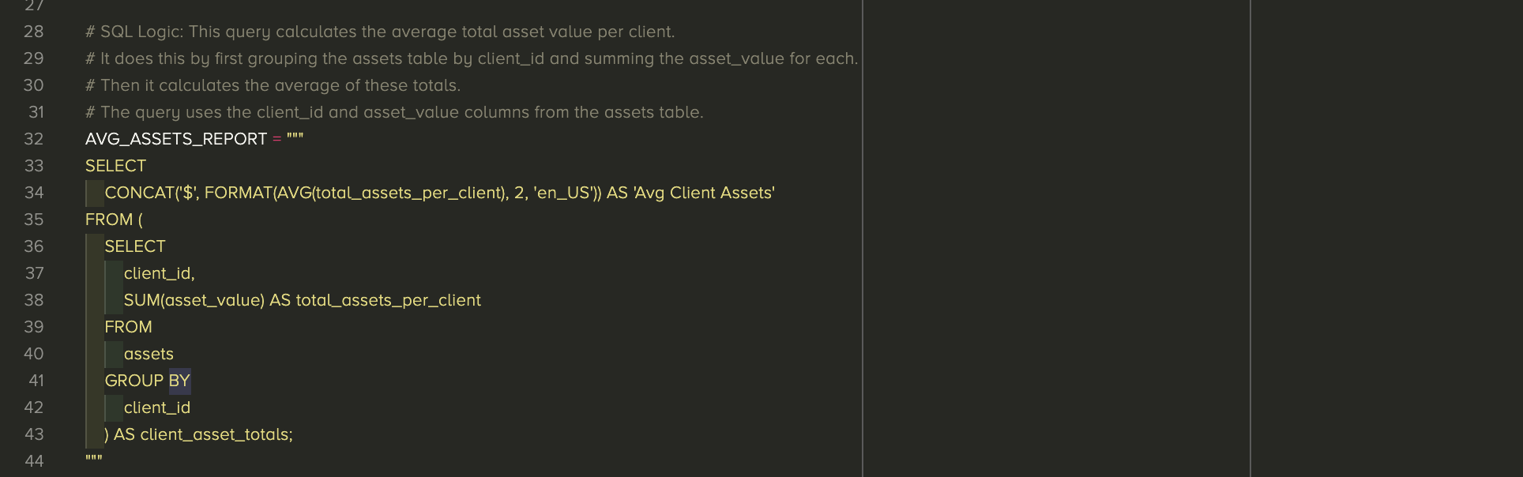
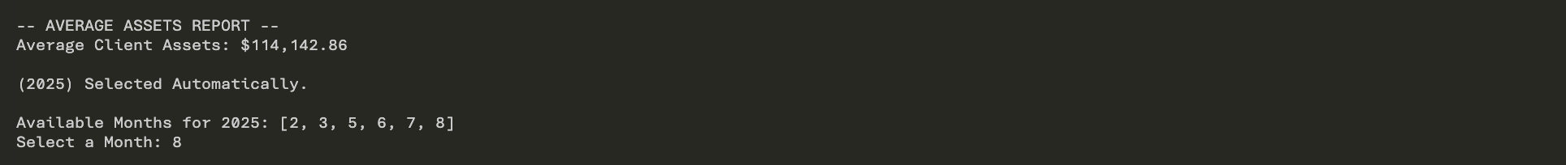
Report 2 – Average Assets Per Client
Business Need: Gauge typical portfolio size. Inform strategy.
Description: Average of total assets per client.

Slide 9
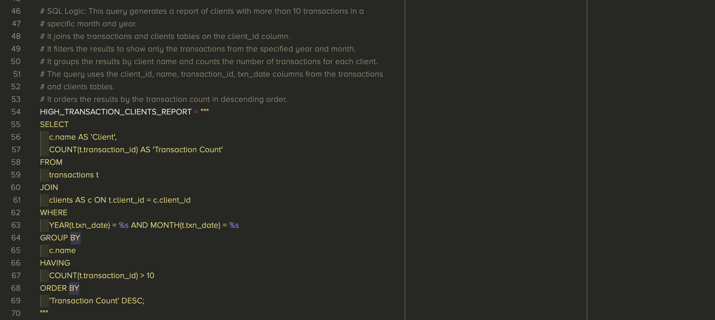
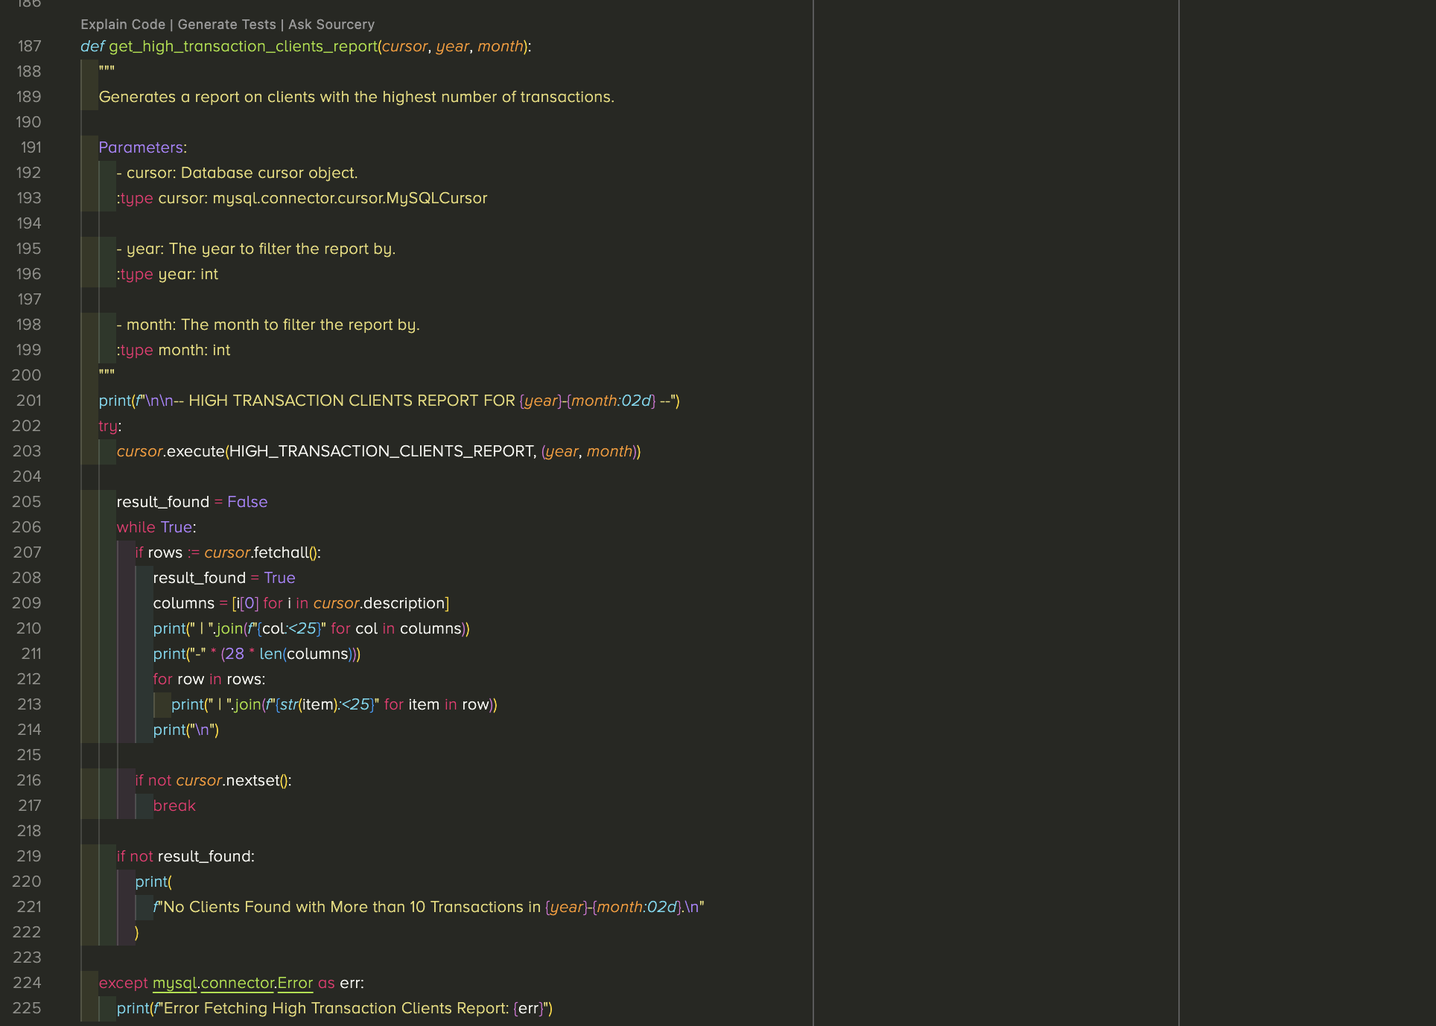
Report 3 – High-Transaction Clients
Business Need: Spot high-activity clients for service/billing.
Description: Clients with > 10 transactions in a chosen month/year.

Slide 10
References & Implementation
SQL: willson_financial_init.sql
1
Python: constants.py, display_data.py
2
Business Logic Per Willson Financial Case Study
3

Slide 11

Thank You! Questions

